Slide 1
Car Accident Severity in the UK
By: Taha Ansari

Slide 2
Car Accident severity is valuable for authority
Local authority want to know why accidents happen
Less accidents mean that general safety will have increased
If there are less accidents and there is more safety, people will be more inclined to move to the country or come to visit
Finding out severity is also very important as if the majority of the cases are severe the country must find out immediately why that is the case.

Slide 3
Data
Data was obtained from a database of UK traffic accidents from 2005-2015
Data contained:
Number of accidents
Number of accidents on each day of the week
Number of casualties
Type of casualties (pedestrian, civilian ,etc)
Data had to be cleaned up, making it easier to use

Slide 4
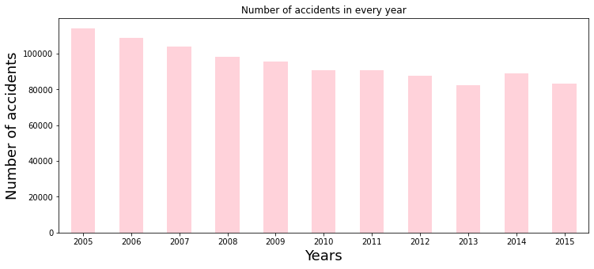
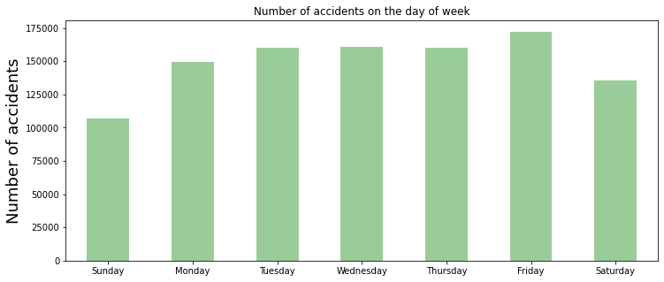
General Information

Slide 5
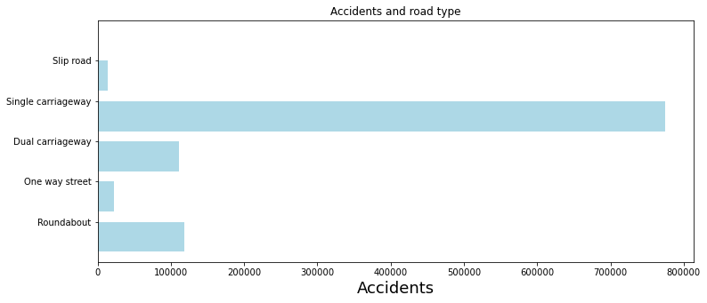
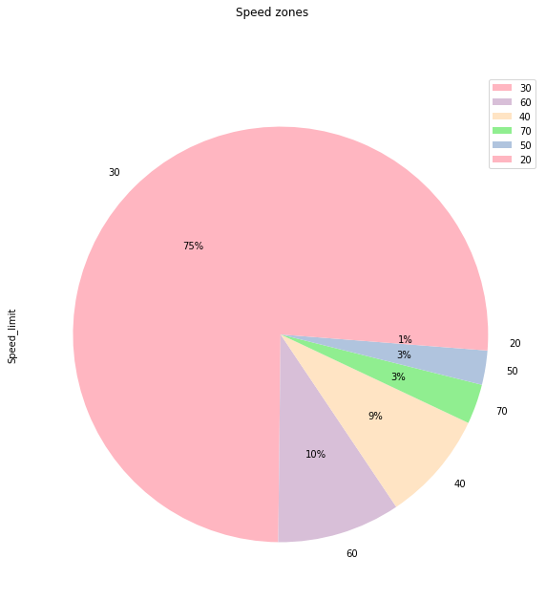
What speed accidents occurred in and where

Slide 6
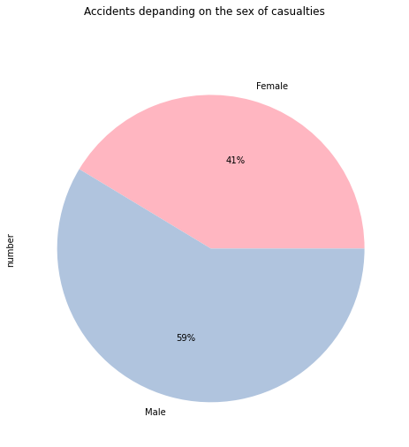
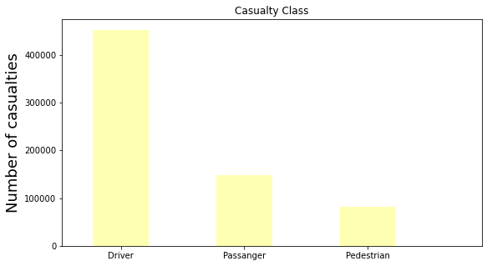
Information on casualties

Slide 7
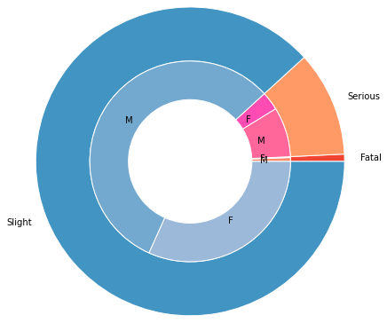
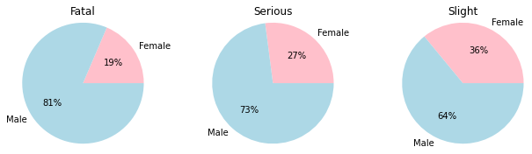
Type of accident and who was affected

Slide 8
Conclusion and future directions
Hopefully the information will be used by local authority to see patterns and trends
The local authority should investigate more into accidents per speed zone and figure out ways to improve this(e.g more training regarding this matter in driving schools)
Find data from the past 5 years (to spot any more trends)
There are still other factors that need to be discussed such as what area the accidents are most frequent in

